Slide 1
Introduction to Selenium

Slide 2
Objectives
By the end of this session, you will:
Discover what is Selenium and how can it help test your Web applications.
Explore the Selenium IDE to automate common user interface tests.
Generate custom Java code for enhanced flexibility.
Organize your code using the Page Object Model (POM) to improve maintainability and readability.

Slide 3
What is Selenium?
Selenium is an open-source framework
Automates web browser interactions
Can be used for testing web applications.
Works seamlessly across different browsers
Enables you as a developer to perform functional tests.
History
Originated in 2004 at ThoughtWorks, a firm in Chicago.
Developed by Jason Huggins as a tool called JavaScriptTestRunner

Slide 4


Selenium components
Selenium IDE
Can record and replaying test cases
Available as a browser extension
2. Selenium WebDriver
For writing automation scripts in multiple languages
Use it to interact directly with browsers and testing scenarios.
3. Selenium Grid
Enables parallel test execution across multiple machines and browsers.

Slide 5
What is Selenium IDE?
Is a browser extension
Can record and play back user interactions with web application
Ideal for automated UI tests
Requires no coding
Supports multiple browsers
Built-in debugging and troubleshooting tools
Can export its recorded macro into many coding languages

Slide 6
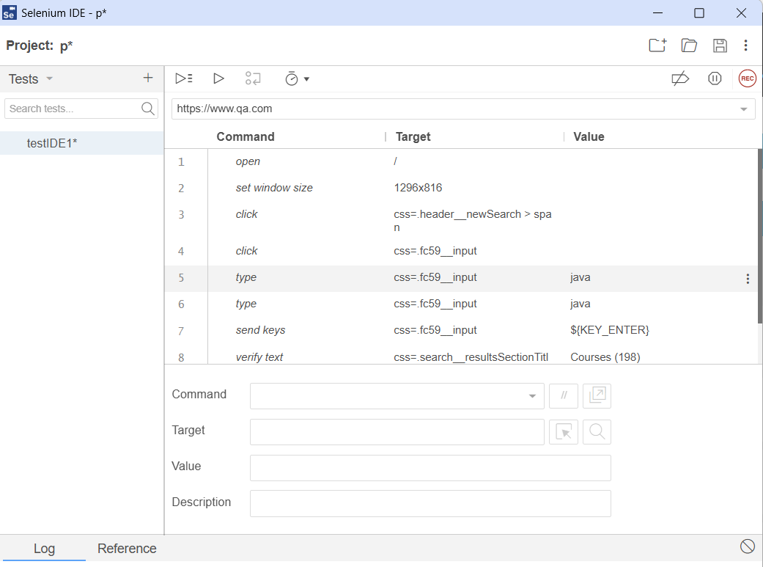
Trainer demo
Record a macro
Create a test
Play back the recorded test
Change the play back speed
The step-over button
Comment a step out
View the log file
Save and Open tests
Export to other languages

Slide 7
Lab
In this lab you will:
Record a macro
Create a test
Play back the recorded test
Change the play back speed
The step-over button
Comment a step out
View the log file
Save and Open tests
Export to other languages

Slide 8
Using code
Advantages of using Code
Allows you to modify the script as requirements change
Scripts can be integrated with version control
Trail of each application version to the specific code version
Enable other developers to participate
Can share code…

Slide 9
WebDriver tool
Used in automated web testing
Allows you to interact directly with web browsers.
Part of the Selenium framework
Serves as a bridge between your test scripts and the browser
Can be downloaded
First you must identify your browser version
For Chrome, go to the download page.
For Firefox, visit the GeckoDriver page.
For Edge, check the Microsoft Edge WebDriver page.
For Safari, SafariDriver is built into macOS

Slide 10
Code in Java Maven app – Set dependencies in pom.xml
<project xmlns=http://maven.apache.org/POM/4.0.0 xmlns:xsi=http://www.w3.org/2001/XMLSchema-instance xsi:schemaLocation="http://maven.apache.org/POM/4.0.0 http://maven.apache.org/xsd/maven-4.0.0.xsd">
<modelVersion>4.0.0</modelVersion> <groupId>com.example</groupId> <artifactId>minimal-selenium-project</artifactId> <version>1.0-SNAPSHOT</version>
<dependencies> <dependency> <groupId>org.seleniumhq.selenium</groupId> <artifactId>selenium-java</artifactId> <version>4.10.0</version> </dependency>

Slide 11
Pom.xml dependencies…
<dependency> <groupId>io.github.bonigarcia</groupId> <artifactId>webdrivermanager</artifactId> <version>5.9.3</version> <!-- Use the latest version --> </dependency>
<dependency> <groupId>org.slf4j</groupId> <artifactId>slf4j-simple</artifactId> <version>2.0.6</version> </dependency>
</dependencies> </project>
Optional: SLF4J (Simple Logging Facade for Java) You can provide a logging library for it to work.
Notes:
Alternative to SDL4J <dependency>
<groupId>ch.qos.logback</groupId>
<artifactId>logback-classic</artifactId>
<version>1.2.11</version>
</dependency>

Slide 12
Sample exported code in Java
Imports
import java.time.Duration;
import org.openqa.selenium.*;
import org.openqa.selenium.WebDriver;
import org.openqa.selenium.firefox.FirefoxDriver;
import org.openqa.selenium.support.ui.ExpectedConditions;
import org.openqa.selenium.support.ui.WebDriverWait;

Slide 13
Code sample
static WebDriver driver;
public static void main(String[] args) { JavascriptExecutor js; driver = new FirefoxDriver(); js = (JavascriptExecutor) driver; driver.get("https://www.qa.com/"); driver.findElement(By.linkText("Search")).click(); driver.findElement(By.cssSelector(".fc59__input")).click(); driver.findElement(By.cssSelector(".fc59__input")).sendKeys("java" + Keys.ENTER); getElementById("CybotCookiebotDialogBodyButtonAccept").click(); }
public static WebElement getElementById(String id) { WebDriverWait wait = new WebDriverWait(driver, Duration.ofSeconds(10)); return wait.until(ExpectedConditions.visibilityOfElementLocated(By.id(id))); }

Slide 14
Test code sample
System.setProperty("webdriver.chrome.driver", "./drivers/chromedriver.exe");
WebDriver driver = new ChromeDriver();
driver = new ChromeDriver();
js = (JavascriptExecutor) driver;
driver.get("https://www.qa.com/");
driver.manage().window().setSize(new Dimension(1296, 816));
driver.findElement(By.cssSelector(".header__newSearch > span")).click();
driver.findElement(By.cssSelector(".fc59__input")).click();
driver.findElement(By.cssSelector(".fc59__input")).sendKeys("java" + Keys.ENTER);
assertEquals(driver.findElement(By.cssSelector(".search__resultsSectionTitle")) .getText(), "Courses (198)");

Slide 15
Thank you

